Slide 1
Cluster Analysis

Slide 2
What is Cluster Analysis?
The process of grouping a set of physical or abstract objects into classes of similar objects is called CLUSTERING.
Cluster: a collection of data objects
Similar to one another within the same cluster
Dissimilar to the objects in other clusters
A cluster of data objects can be treated collectively as one group and so may be considered as a form of data compression.
Cluster analysis
Finding similarities between data according to the characteristics found in the data and grouping similar data objects into clusters
Unsupervised learning: no predefined classes
Called data segmentation because clustering partitions large data sets into groups according to their similarity
Also be used for outlier detection.
Notes:
Problem: You have a basket of fruits and want to organize them into groups based on their similarities.
Solution: Use clustering to group the fruits.
Clustering Process:
Data Collection: List the fruits in the basket (e.g., apple, banana, orange, grape, mango,plum).
Feature Selection: Choose characteristics to compare the fruits (e.g., color, shape, size, taste).
Clustering: Group the fruits based on similar characteristics. For example:
Group 1: Red, round fruits (apple,plum)
Group 2: Yellow, curved fruits (banana, mango)
Group 3: Small, round fruits (grape)

Slide 3
Why Cluster Analysis?
Classification effectively distinguish groups or classes of objects.
It requires collection and labeling of a large set of training tuples or patterns, which the classifier uses to model each group. – Costly
More desirable to proceed in the reverse direction: First partition the set of data into groups based on data similarity (e.g., using clustering), and then assign labels to the relatively small number of groups.
Additional advantages : it is adaptable to changes and helps single out useful features that distinguish different groups.

Slide 4
Examples of Clustering Applications
Marketing: Help marketers discover distinct groups in their customer bases, and then use this knowledge to develop targeted marketing programs
Land use: Identification of areas of similar land use in an earth observation database
Insurance: Identifying groups of motor insurance policy holders with a high average claim cost
City-planning: Identifying groups of houses according to their house type, value, and geographical location
Earth-quake studies: Observed earth quake epicenters should be clustered along continent faults

Slide 5
Cluster Analysis

Slide 6
Requirements of Clustering in Data Mining
Scalability-large database
Ability to deal with different types of attributes
Discovery of clusters with arbitrary shape
Minimal requirements for domain knowledge to determine input parameters
Ablity to deal with noise and outliers
Incremental clustering and insensitivity to order of input records- database updates
High dimensionality
Constraint-based clustering
Interpretability and usability

Slide 7
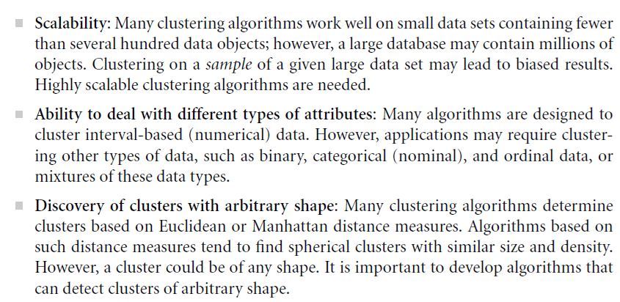

Slide 8
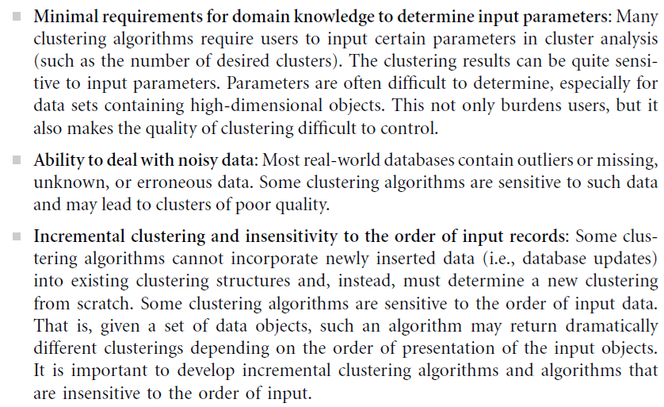

Slide 9
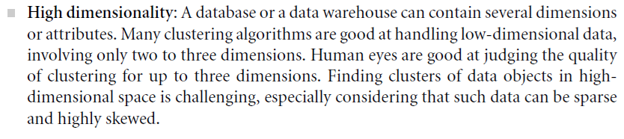
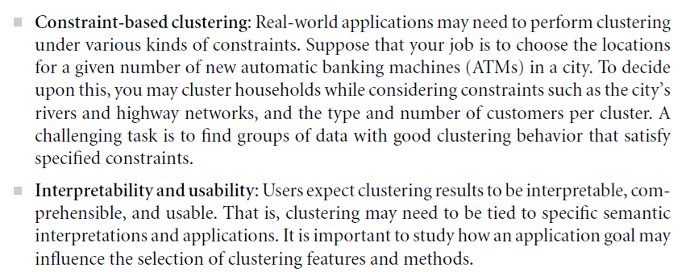

Slide 10
Cluster Analysis
Types of Data in Cluster Analysis

Slide 11
Data Structures
Main memory-based clustering algorithms – 2 Data Structures
Data matrix(OR object-by-variable structure OR Two-mode matrix)
Represents n objects, such as persons, with p variables(also called measurements or attributes), such as age, height, weight, gender.
The structure is in the form of a relational table, or n -by-p matrix (n objects x p variables)
The rows and columns of the data matrix represent different entities- Two-mode matrix

Slide 12
Data Structures
Dissimilarity matrix((or object-by-object structure or One-mode matrix)
Collection of proximities that are available for all pairs of n objects
It is often represented by an n-by-n table.
d(i, j) is the measured difference or dissimilarity between objects i and j.
In general, d(i, j) is a nonnegative number that is close to 0 when objects i and j are highly similar or “near” each other
becomes larger the more they differ.
d(i, j)=d( j, i), and d(i, i)=0
The rows and columns of the dissimilarity matrix represent the same entity- One-mode matrix

Slide 13
Data Structures
Many clustering algorithms operate on a dissimilarity matrix.
If the data are presented in the form of a data matrix, it can first be transformed into a dissimilarity matrix before applying such clustering algorithms.

Slide 14
Type of data in clustering analysis
Interval-scaled variables
Binary variables
Nominal, ordinal variables
Ratio variables
Vector Objects
Variables of mixed types

Slide 15
Interval-Scaled variables
Continuous measurements of a roughly linear scale.
Egs. Weight and height, latitude and longitude coordinates and weather temperature.
The measurement unit used can affect the clustering analysis.
Eg: Using meters to inches for height, or from kilograms to pounds for weight, may lead to a very different clustering structure
Expressing a variable in smaller units will lead to a larger range for that variable, and thus a larger effect on the resulting clustering structure.
To help avoid dependence on the choice of measurement units, the data should be standardized.

Slide 16
Interval-Scaled variables
Standardizing measurements attempts to give all variables an equal weight.
Useful when given no prior knowledge of the data.
However, in some applications, users may intentionally want to give more weight to a certain set of variables than to others.
Eg:clustering basketball player candidates (height)

Slide 17
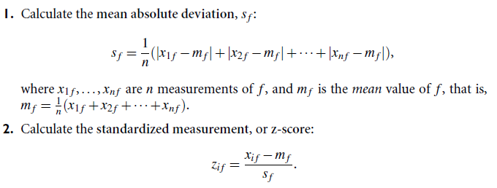
Interval-Scaled variables
How can the data for a variable be standardized?
To standardize measurements, one choice is to convert the original measurements to unitless variables.
Given measurements for a variable f , this can be performed as follows:

Slide 18
Interval-scaled variables
The mean absolute deviation, s_{f} , is more robust to outliers than the standard deviation.
When computing the mean absolute deviation, the deviations from the mean (i.e., |x_{i f} - m_{f} |) are not squared; hence, the effect of outliers is somewhat reduced.
The advantage of using the mean absolute deviation is that the z-scores of outliers do not become too small; hence, the outliers remain detectable.

Slide 19

Similarity and Dissimilarity Between Objects
After standardization, or without standardization, the dissimilarity (or similarity) between the objects described by interval-scaled variables is typically computed based on the distance between each pair of objects.
Some popular ones include: Euclidean distance:
where i = (x_{i1}, x_{i2}, …, x_{in}) and j = (x_{j1}, x_{j2}, …, x_{jn}) are two n-dimensional data objects
Manhattan(or city block) distance

Slide 20
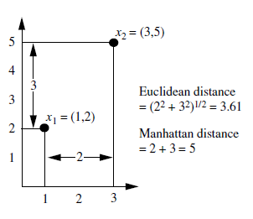
Similarity and Dissimilarity Between Objects (Cont.)
Both the Euclidean distance and Manhattan distance satisfy the following mathematic requirements of a distance function:
Properties
d(i,j) ≥ 0
d(i,i) = 0
d(i,j) = d(j,i)
d(i,j) ≤ d(i,k) + d(k,j) (triangular inequality).
Let x1 = (1, 2) and x2 = (3, 5) represent two objects.
The Euclidean distance between the two is p
The Manhattan distance between the two is 2+3 = 5.

Slide 21
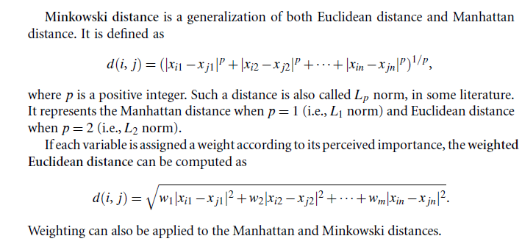
Similarity and Dissimilarity Between Objects (Cont.)

Slide 22
Binary Variables
A binary variable has only two states: 0 or 1
0 means that the variable is absent, and 1 means that it is present
Eg. Variable smoker describing a patient
Treating binary variables as if they are interval-scaled can lead to misleading clustering results.
Methods specific to binary data are necessary for computing dissimilarities.

Slide 23
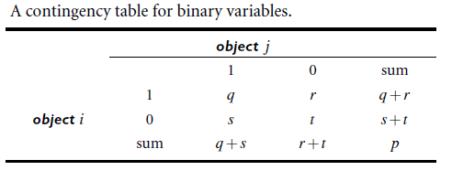
Binary Variables
Computing a dissimilarity matrix from the given binary data.
If all binary variables have the same weight, we have the 2-by-2 contingency table
q is the number of variables that equal 1 for both objects i and j
r is the number of variables that equal 1 for object i but that are 0 for object j
s is the number of variables that equal 0 for object i but equal 1 for object j, and
t is the number of variables that equal 0 for both objects i and j.
The total number of variables is p, where p = q+r+s+t

Slide 24

Binary Variables
A binary variable is symmetric if both of its states are equally valuable and carry the same weight;
i.e; there is no preference on which outcome should be coded as 0 or 1.
Eg: the attribute gender having the states male and female.
Dissimilarity that is based on symmetric binary variables is called symmetric binary dissimilarity.
Its dissimilarity (or distance) measure, can be used to assess the dissimilarity between objects i and j.

Slide 25

Binary Variables
A binary variable is asymmetric if the outcomes of the states are not equally important.
Eg: the positive and negative outcomes of a disease test.
The most important outcome, which is usually the rarest one, by 1 (e.g., HIV positive) and the other by 0 (e.g., HIV negative).
Given two asymmetric binary variables, the agreement of two 1s (a positive match) is then considered more significant than that of two 0s (a negative match).
Therefore, such binary variables are often considered “monary” (as if having one state).
The dissimilarity based on such variables is called asymmetric binary dissimilarity, where the number of negative matches, t, is considered unimportant and thus is ignored in the computation.

Slide 26

Binary Variables
We can measure the distance between two binary variables based on the notion of similarity instead of dissimilarity.
For eg: the asymmetric binary similarity between the objects i and j, or sim(i, j), can be computed as,
The coefficient sim(i, j) is called the Jaccard coefficient.
When both symmetric and asymmetric binary variables occur in the same data set, the mixed variables approach can be applied.

Slide 27
Dissimilarity between Binary Variables
Example
Name is the object identifier
Gender is a symmetric attribute
The remaining attributes are asymmetric binary
For asymmetric attribute values, let the valuesY (yes)andP(positive)be set to1,and the value N (no or negative) be set to 0.
Suppose that the distance between objects (patients)is computed based only on the asymmetric variables.

Slide 28
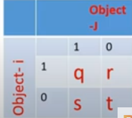
Dissimilarity between Binary Variables
The distance between each pair of the three patients, Jack, Mary, and Jim, is
These measurements suggest that Mary and Jim are unlikely to have a similar disease because they have the highest dissimilarity value among the three pairs.
Of the three patients, Jack and Mary are the most likely to have a similar disease.

Slide 29
Categorical Variables
A generalization of the binary variable in that it can take more than 2 states, e.g., red, yellow, blue, green.
How is dissimilarity computed between objects described by categorical variables?”
Method 1: Simple matching
The dissimilarity between two objects i and j can be computed based on the ratio of mismatches
m is the number of matches (i.e., the number of variables for which i and j are in the same state),
p is the total number of variables.
Weights can be assigned to increase the effect of m or to assign greater weight to the matches in variables having a larger number of states.

Slide 30
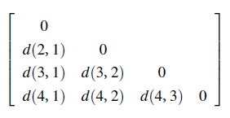
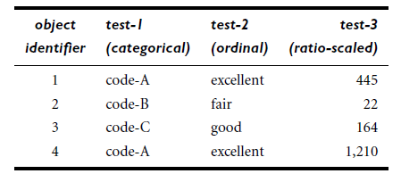
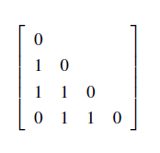
Example
compute the dissimilarity matrix
Since, one categorical variable, test-1, we set p = 1 so that d(i, j) evaluates to 0 if objects i and j match, and 1 if the objects differ.

Slide 31
Categorical Variables
Method 2: Categorical variables can be encoded by asymmetric binary variables by creating a new binary variable for each of the M states.
For an object with a given state value, the binary variable representing that state is set to 1, while the remaining binary variables are set to 0.
For example, to encode the categorical variable map color, a binary variable can be created for each of the five colors listed above.
For an object having the color yellow, the yellow variable is set to 1, while the remaining four variables are set to 0.
The dissimilarity coefficient is then calculated.

Slide 32
Ordinal Variables
An ordinal variable can be discrete or continuous
A discrete ordinal variable resembles a categorical variable, except that the M states of the ordinal value are ordered in a meaningful sequence.
Ordinal variables are very useful for registering subjective assessments of qualities that cannot be measured objectively.
Discrete- assistant, associate, and full for professors
Continuous - rank

Slide 33
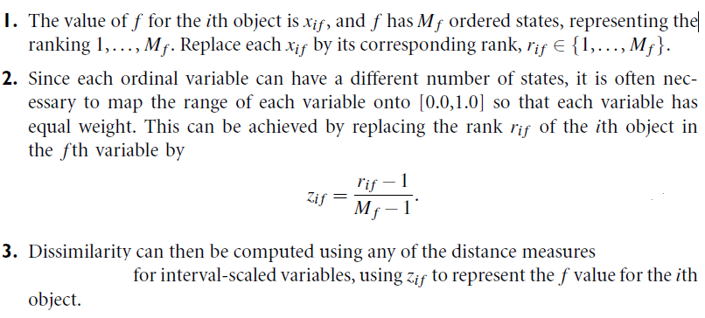
Ordinal Variables
The dissimilarity computation with respect to f involves the following steps:

Slide 34
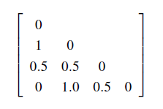
Example
Replacing with the computed value
1
0
0.5
1
Rank:3-excellent, 2-good,1-fair
Normalizing Rank:1-excellent, 0.5-good,0-fair
Normalized rank values
Taking Manhattan Distance
Fair(1) | =(1-1)/(3-1) | 0
Good(2) | =(2-1)/(3-1) | 0.5
Excellent(3) | =(3-1)/(3-1) | 1

Slide 35
Ratio-Scaled Variables
Ratio-scaled variable: Makes a positive measurement on a nonlinear scale, approximately at exponential scale, such as Ae ^{Bt} or Ae ^{-Bt} , A, B -positive constants, t - time
Eg. Growth of a bacteria population or the decay of a radioactive element

Slide 36
Ratio-Scaled Variables
There are three methods to handle ratio-scaled variables for computing the dissimilarity between objects.
1. Treat ratio-scaled variables like interval-scaled variables. This, however, is not usually a good choice since it is likely that the scale may be distorted.
2. Apply logarithmic transformation to a ratio-scaled variable f having value x_{i f} for object i by using the formula y_{i f} = log(x_{i f} ). The y_{i f} values can be treated as interval-valued.
For some ratio-scaled variables, log-log or other transformations may be applied, depending on the variable’s definition and the application.
3. Treat x_{i f} as continuous ordinal data and treat their ranks as interval-valued.
The latter two methods are the most effective, although the choice of method used may depend on the given application.

Slide 37
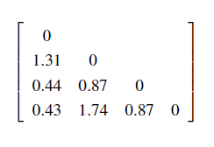
Example
Log(x)
2.65
1.34
2.21
3.08
Taking Manhattan Distance

Slide 38
Variables of Mixed Types
One approach is to group each kind of variable together, performing a separate cluster analysis for each variable type.
This is feasible if these analyses derive compatible results.
A more preferable approach is to process all variable types together, performing a single cluster analysis.
One technique => combine the different variables into a single dissimilarity matrix, bringing all of the meaningful variables onto a common scale of the interval [0.0,1.0].

Slide 39
Variables of Mixed Types
One approach is to group each kind of variable together, performing a separate cluster analysis for each variable type.
This is feasible if these analyses derive compatible results.
A more preferable approach is to process all variable types together, performing a single cluster analysis.
One technique => combine the different variables into a single dissimilarity matrix, bringing all of the meaningful variables onto a common scale of the interval [0.0,1.0].

Slide 40
Variables of Mixed Types
A database may contain all the six types of variables
symmetric binary, asymmetric binary, categorical, ordinal, interval and ratio
Suppose that the data set contains p variables of mixed type.
The dissimilarity d(i, j) between objects i and j is defined as
δ = 0 if either
x _{i f} or x _{j f} is missing
x _{i f} = x _{j f} = 0 and variable f is an asymmetric binary
Otherwise, δ = 1

Slide 41
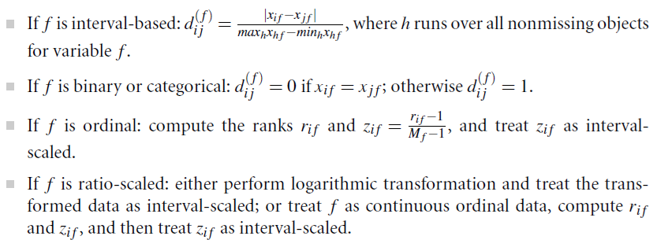
Variables of Mixed Types
Computation depends on its type

Slide 42
Dissimilarity between variables of mixed type.
We will consider all of the variables, which are of different types.
Consider the dissimilarity matrices of all the variables.

Slide 43
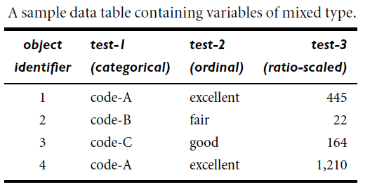

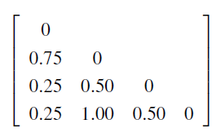
Dissimilarity between variables of mixed type.
Normalize the values so that it can be wrapped [0.0,1.0]
Log(x)
2.65
1.34
2.21
3.08
Normalize by dividing each one by (3.0 -1.34) = 1.74
Dissimilarity matrix for test -1
Dissimilarity matrix for test -2
Dissimilarity matrix for test -3

Slide 44

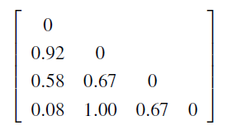


Dissimilarity between variables of mixed type.
Use the dissimilarity matrices for the three variables in our computation

Slide 45
Cluster Analysis
What is Cluster Analysis?
Types of Data in Cluster Analysis
A Categorization of Major Clustering Methods
Partitioning Methods
Hierarchical Methods
Density-Based Methods
Grid-Based Methods
Model-Based Methods

Slide 46
Major Clustering Approaches
Partitioning approach:
Given a database of n objects or data tuples
Constructs k partitions of the data, where each partition represents a cluster and k <= n
Each group must contain at least one object
Each object must belong to exactly one group
A partitioning method creates an initial partitioning.
Then uses an iterative relocation technique by moving objects from one group to another
Then evaluate them by some criterion.
Typical methods: k-means, k-medoids, CLARANS
Density-based approach:
Based on connectivity and density functions
Arbitrary-shaped clusters
Typical methods: DBSCAN, OPTICS, DENCLUE

Slide 47
Major Clustering Approaches
Hierarchical approach:
Create a hierarchical decomposition of the set of data (or objects) using some criterion
Agglomerative approach(bottom-up approach)
Divisive approach(top-down approach)
Typical methods: Diana, Agnes, BIRCH, ROCK, CHAMELEON
Grid-based approach:
Quantize the object space into a finite number of cells that form a grid structure.
The main advantage of this approach is its fast processing time.
Typically independent of the number of data objects and dependent only on the number of cells in each dimension in the quantized space.
Typical methods: STING, WaveCluster, CLIQUE

Slide 48
Major Clustering Approaches
Model-based:
A model is hypothesized for each of the clusters and tries to find the best fit of that model to each other
Typical methods: EM, SOM, COBWEB
Clustering high-dimensional data
Subspace clustering methods –CLIQUE, PROCLUS
Frequent pattern-based clustering –pCluster
extracts distinct frequent patterns among subsets of dimensions that occur frequently
User-guided or constraint-based:
Clustering by considering user-specified or application-specific constraints
Typical methods: COD (obstacles), constrained clustering
Notes:
expectation-maximization analysis
self-organizing feature map

